Slide 1
Esfp-2 project River Management System
MADE BY: Rahul Prajapati
Purav Patel
Vedant Patel

Slide 2
Plan Of Project
Create an Algorithm of the program code
Create main function according to Algorithm and requires declare variables inside main function
Create the class RMS and then inside that two subclasses
Now declare variables inside each class as requiration and Algorithm
Then create functions needed in program
Make objects of classes according to Algorithm
Then redirect all the data in the .txt file to create database of program

Slide 3
Concepts used
Class and objects
File handling
Loops
Logical operations
Switch cases
If/else conditions
Goto functions
I/O management

Slide 4
Algorithm
START
Define a class RMS
Define two subclasses State and River
Declare variables in both classes State and River as required
Define Main function
Declare variables in main function as required
Create a array object of RMS function in main function
Create a object of State class and River class in RMS class
Define a function get_data(int i) in State class to get data of States
Define a function get_data(int i) in River class to get data of Rivers
Define a function display_ststes_rainfall_greaterthan500() for task 1
Define a function display_river_water_intake_atleast7000() for task 2
Define a function display_population_more_then_1000() for task 3
Define a function display_river_length_greater_than_3() for task 4

Slide 5
15. Define a function display_water_intake_then_8000() for task 5
16. Define a function display_river_length_greater_than_2() for task 6
17. Implement code According to the tasks in their respective functions
18. now using file handling object ifstream create a object nd open the database file and redirect all the data into that
19. and close the file using close() function
20. Declare a switch case to call the functions according to choice and get the output
21. Now ask user that do he want to chek something else
22. if yes then using goto function jump to the MENU part and then again ask the user his choice
23. END

Slide 6
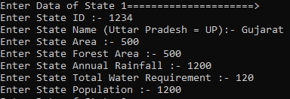
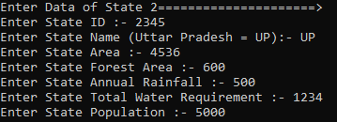
Data entry
Data Entry of State 1
Data Entry of State 2

Slide 7
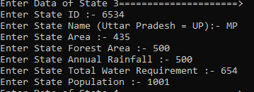
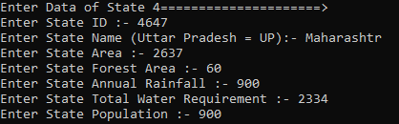
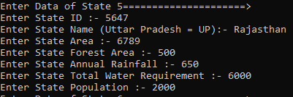
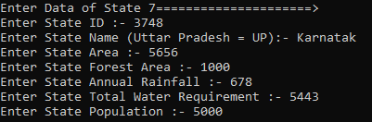
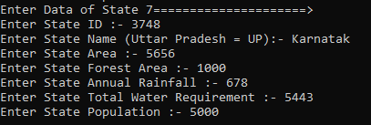
DATA OF STATE 3
DATA OF STATE 4
Data of state 5
DATA OF STATE 6
Data of state 7

Slide 8
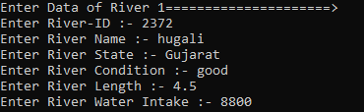
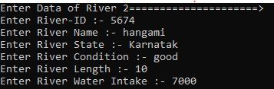
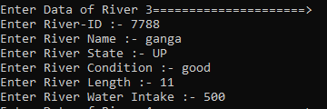
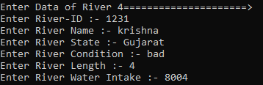
DATA OF RIVER 1
DATA OF RIVER 2
DATA OF RIVER 3
DATA OF RIVER 4

Slide 9
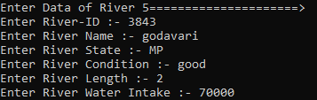
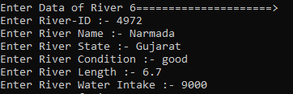
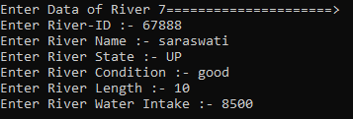
DATA OF RIVER 5 DATA OF RIVER 6
DATA OF RIVER 7

Slide 10
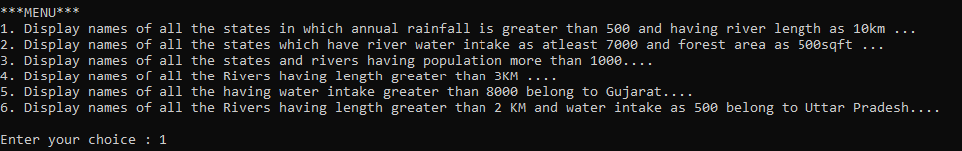

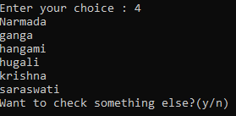
If we chooses option 1 then it will display all the states having annual rainfall greater than 500 and having river length as 10 KM
Then after giving y it will again show the menu and you will have to choose on e more option and if chooses option 4 then it will display all the rivers having length more than 3 KM
And this process will happen again and again until you don’t gives n as answer

Slide 11
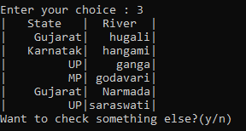

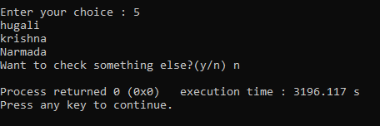
If you chooses option 3 then it will display all states alphabetically shorted havin population more than 1000
If we chooses option 2 then it will display name of states having atleast 7000 as water intake and forest area of 500
If we chooses option 5 then it will display name of all the rivers having watter intake greater than 8000 and belongs to Gujarat

Slide 12
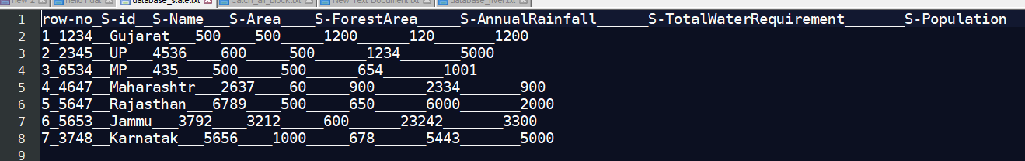
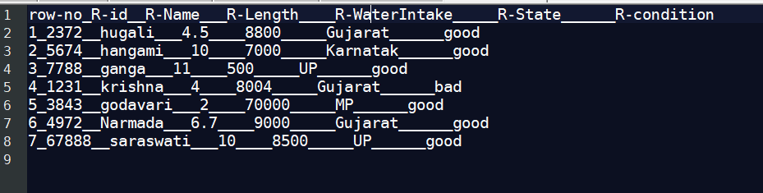
DATABASE OF STATES IN DATABASE_STATE.TXT FILE
DATABASE OF RIVERS IN DATABASE_RIVER.TXT FILE

Slide 13
Thank you

